Slide 1
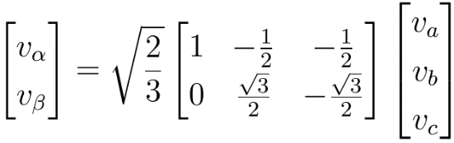
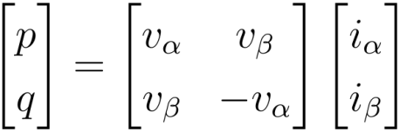
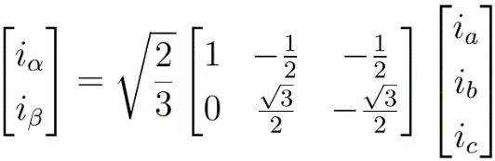
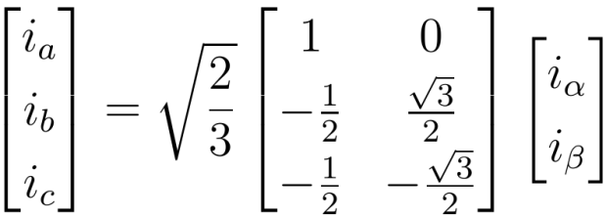
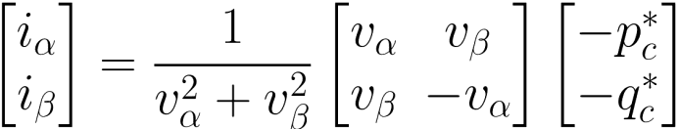






















$$v_{a}$$
Transformada de Clarke
Cálculo de Potências Instantâneas
1
$$v_{b}$$
$$v_{α}$$
$$v_{c}$$
$$v_{β}$$
$$i_{La}$$
$$i_{α}$$
$$i_{Lb}$$
$$i_{β}$$
$$i_{Lc}$$
$$p$$
$$q$$
$$p_{c}^{∗}$$
$$q_{c}^{∗}$$
Seleção de Potências a serem Compensadas
1
$$i_{Ca}^{∗}$$
$$v_{α}$$
$$i_{Cα}^{∗}$$
$$i_{Cb}^{∗}$$
$$v_{β}$$
$$i_{Cβ}^{∗}$$
$$i_{Cc}^{∗}$$
$$α−β$$
Cálculo de Corrente
Transformada Inversa de Clarke

Slide 2
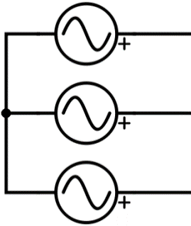
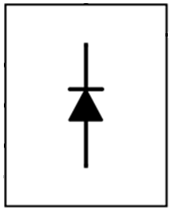















Fonte de Tensão Trifásica
Carga Não Linear
$$v_{Sa}$$
$$i_{Sa}$$
$$i_{La}$$
$$v_{Sb}$$
$$i_{Sb}$$
$$i_{Lb}$$
$$v_{Sc}$$
$$i_{Sc}$$
$$i_{Lc}$$
$$i_{Ca}^{}$$
$$i_{Cb}^{}$$
$$i_{Cc}^{}$$
$$i_{Ca}^{∗}$$
Correntes de Referência
$$i_{Cb}^{∗}$$
$$i_{Cc}^{∗}$$
Compensador

Slide 3
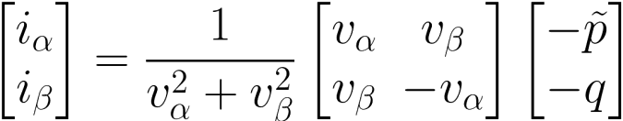












$$v_{Sa}$$
Transformada de Clarke
Cálculo de Potências Instantâneas
1
$$v_{Sb}$$
$$v_{α}$$
$$v_{Sc}$$
$$v_{β}$$
$$i_{La}$$
$$i_{α}$$
$$i_{Lb}$$
$$i_{β}$$
$$i_{Lc}$$
$$\overline{p}$$
$$\overline{p}$$
+
FPB
$$p$$
$$q$$
-
+
-
$$−\tilde{p}$$
$$−q$$
$$−1$$
1
$$i_{Ca}^{∗}$$
$$v_{α}$$
$$i_{Cα}^{∗}$$
$$i_{Cb}^{∗}$$
$$v_{β}$$
$$i_{Cβ}^{∗}$$
$$i_{Cc}^{∗}$$
$$α−β$$
Cálculo de Corrente
Transformada Inversa de Clarke

Slide 4
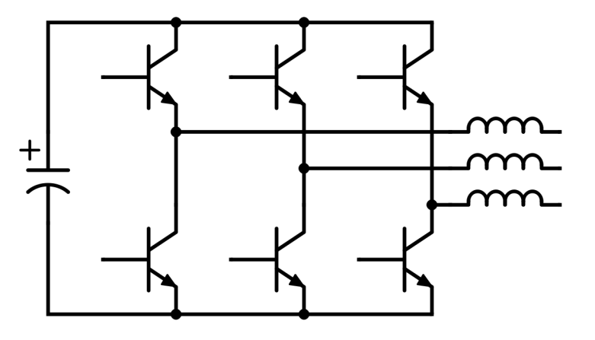


















Fonte de Tensão Trifásica
Carga Não Linear
$$v_{Sa}$$
$$i_{Sa}$$
$$i_{La}$$
$$v_{Sb}$$
$$i_{Sb}$$
$$i_{Lb}$$
$$v_{Sc}$$
$$i_{Sc}$$
$$i_{Lc}$$
$$i_{Ca}^{}$$
$$i_{Cb}^{}$$
$$i_{Cc}^{}$$
$$i_{La}$$
$$i_{Lb}$$
$$i_{Lc}$$
$$v_{Sa}$$
DSP
PWM
$$v_{Sb}$$
$$v_{Sc}$$

Slide 5
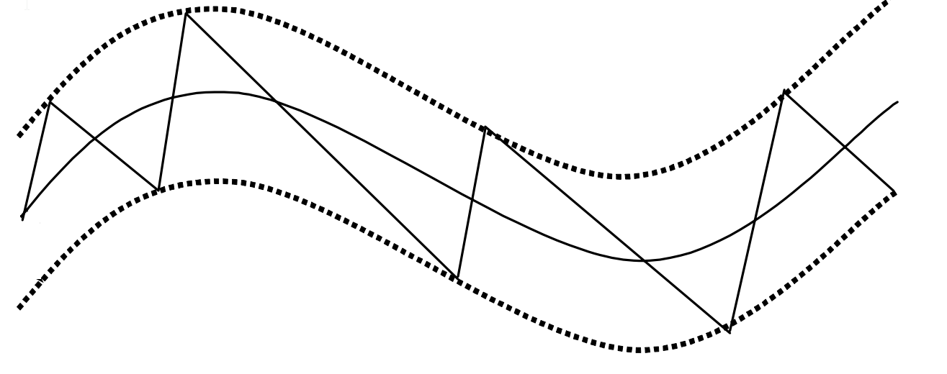
Banda de histerese
Sinal na saída
Sinal PWM

Slide 6
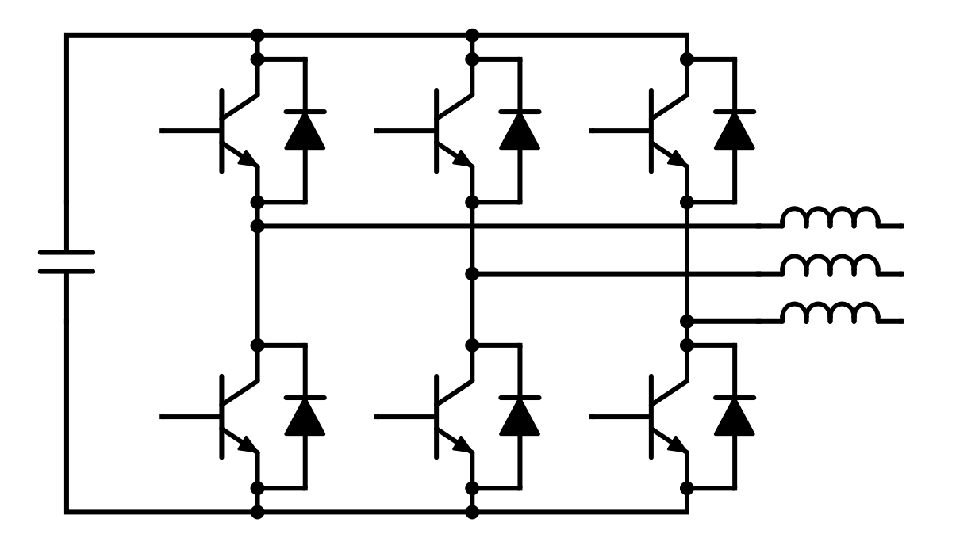
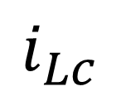

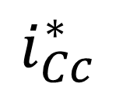

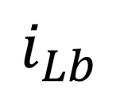
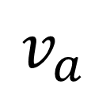
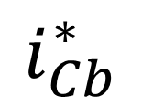
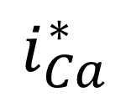
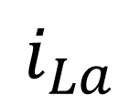
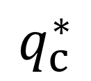
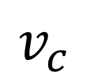
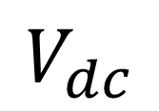
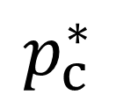
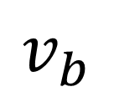

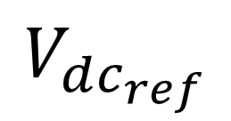
$$V_{dc_{ref}}$$
$$V_{dc}$$
+
-
$$v_{a}$$
$$v_{b}$$
$$v_{c}$$
$$i_{La}$$
Cálculo de Potências Instantâneas
Controlador PI
$$i_{Lb}$$
$$i_{Lc}$$
$$p_{loss}$$
$$p$$
$$q$$
$$i_{Ca}^{∗}$$
$$p_{c}^{∗}$$
+
Seleção de Potência a serem Compensadas
+
Cálculo das Correntes de Referência
Controle PWM
$$i_{Cb}^{∗}$$
$$q_{c}^{∗}$$
$$i_{Cc}^{∗}$$

Slide 7
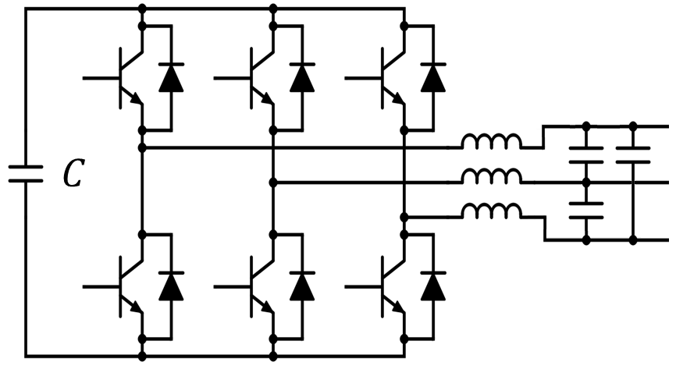
Indutância de Acoplamento
Filtro Capacitivo

Slide 8

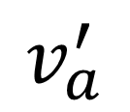
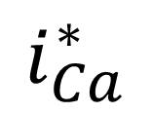
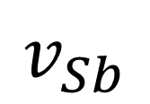
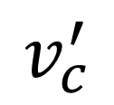
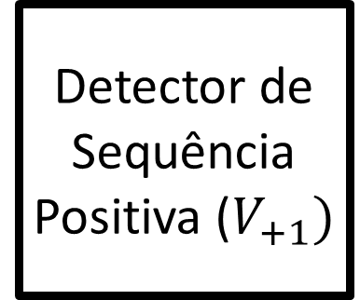
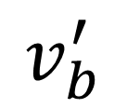
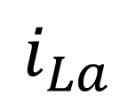
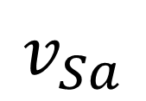
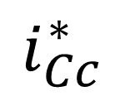
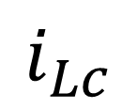
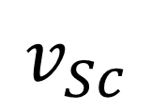
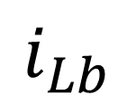
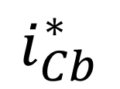
$$v_{Sa}$$
$$v_{a}^{′}$$
Detector de Sequência Positiva ($V_{+1})$
Cálculo de Correntes de Referência
$$v_{Sb}$$
$$v_{b}^{′}$$
$$i_{Ca}^{∗}$$
$$v_{Sc}$$
$$v_{c}^{′}$$
Controle PWM
$$i_{Cb}^{∗}$$
$$i_{La}$$
$$i_{Cc}^{∗}$$
$$i_{Lb}$$
$$i_{Lc}$$

Slide 9
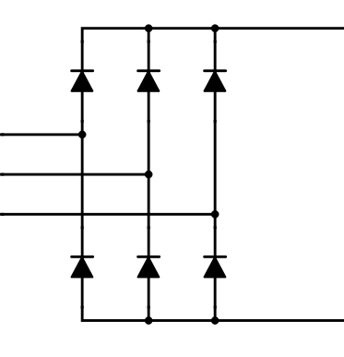
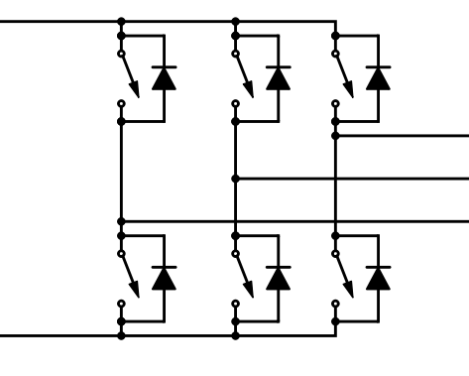
Driver DC - DC
Motor
Retificador
Inversor

Slide 10
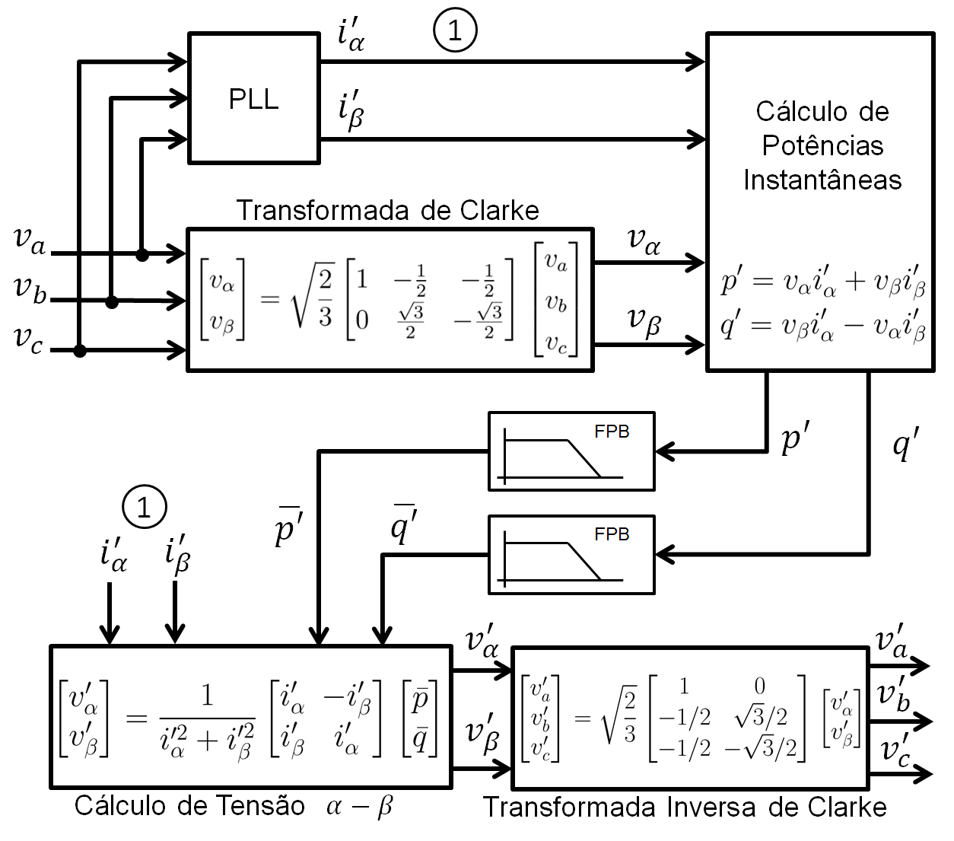














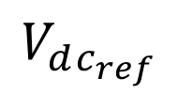















GEN
$$v_{a}$$
$$i_{La}$$
$$i_{Lb}$$
$$i_{Lc}$$
$$v_{b}$$
$$v_{c}$$
$$V_{dc_{ref}}$$
$$V_{dc}$$
3
-
+
PWM
$$i_{Ca}^{∗}$$
Transformada Inversa de Clarke
Controlador PI
Controle por Histerese
$$i_{Cb}^{∗}$$
$$i_{Cc}^{∗}$$
$$p_{loss}$$
$$i_{Cα}^{∗}$$
$$i_{Cβ}^{∗}$$
Transformada de Clarke
2
Cálculo de Potências Instantâneas
$$v_{α}^{′}$$
$$p$$
$$\overline{p}$$
$$−\tilde{p}+p_{loss}$$
FPB
+
$$v_{β}^{′}$$
+
-
$$i_{α}$$
$$i_{β}$$
$$q$$
$$−q$$
$$−1$$
Cálculo de Corrente
$$α−β$$
$$v_{α}^{′}$$
$$v_{β}^{′}$$
$$i_{La}$$
$$i_{Lb}$$
$$i_{Lc}$$
2
3

Slide 11



$$v_{a}$$
Clarke Transformation
1
Instantaneous Power Calculation
$$v_{b}$$
$$v_{α}$$
$$v_{c}$$
$$v_{β}$$
$$i_{La}$$
$$i_{α}$$
$$i_{Lb}$$
$$i_{β}$$
$$i_{Lc}$$
$$p$$
$$q$$
$${−p}_{c}^{∗}$$
$${−q}_{c}^{∗}$$
Selection of the Power to be Compensated
1
$$i_{Cα}^{∗}$$
$$i_{Ca}^{∗}$$
$$v_{α}$$
$$i_{Cb}^{∗}$$
$$v_{β}$$
$$i_{Cβ}^{∗}$$
$$i_{Cc}^{∗}$$
$$α−β$$
Current Calculation
Inverse Clarke Transformation

Slide 12

Clarke Transformation
Instantaneous Power Calculation
$$v_{Sa}$$
1
$$v_{Sb}$$
$$v_{α}$$
$$v_{Sc}$$
$$v_{β}$$
$$i_{La}$$
$$i_{α}$$
$$i_{Lb}$$
$$i_{β}$$
$$i_{Lc}$$
$$\overline{p}$$
$$\overline{p}$$
+
FPB
$$p$$
$$q$$
-
+
-
$$−\tilde{p}$$
$$−q$$
$$−1$$
1
$$i_{Ca}^{∗}$$
$$v_{α}$$
$$i_{Cα}^{∗}$$
$$i_{Cb}^{∗}$$
$$v_{β}$$
$$i_{Cβ}^{∗}$$
$$i_{Cc}^{∗}$$
$$α−β$$
Current Calculation
Inverse Clarke Transformation

Slide 13
3-phase Voltage Power Supply
Non-Linear Load
$$v_{Sa}$$
$$i_{Sa}$$
$$i_{La}$$
$$v_{Sb}$$
$$i_{Sb}$$
$$i_{Lb}$$
$$v_{Sc}$$
$$i_{Sc}$$
$$i_{Lc}$$
$$i_{Ca}^{}$$
$$i_{Cb}^{}$$
$$i_{Cc}^{}$$
$$i_{Ca}^{∗}$$
Reference Currents
$$i_{Cb}^{∗}$$
$$i_{Cc}^{∗}$$
Compensator

Slide 14
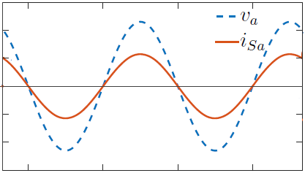
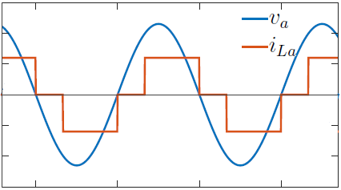
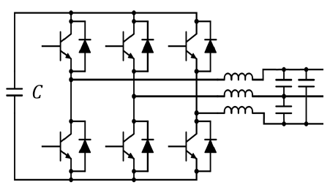
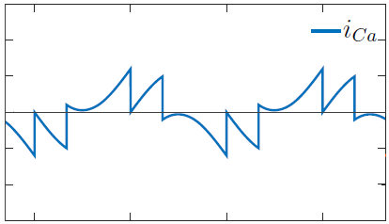















3-phase Voltage Power Supply
Non-Linear Load
$$v_{Sa}$$
$$i_{Sa}$$
$$i_{La}$$
$$v_{Sb}$$
$$i_{Sb}$$
$$i_{Lb}$$
$$v_{Sc}$$
$$i_{Sc}$$
$$i_{Lc}$$
$$i_{Ca}^{}$$
$$i_{Cb}^{}$$
$$i_{Cc}^{}$$
$$i_{Ca}^{∗}$$
Reference Currents
$$i_{Cb}^{∗}$$
$$i_{Cc}^{∗}$$
Compensator
Voltage Source Converter (VSC)

Slide 15









GEN
$$v_{a}$$
$$i_{La}$$
$$i_{Lb}$$
$$i_{Lc}$$
$$v_{b}$$
$$v_{c}$$
$$V_{dc_{ref}}$$
$$V_{dc}$$
3
-
+
Compensador
PWM
$$i_{Ca}^{∗}$$
Transformada Inversa de Clarke
Controlador PI
Controle por Histerese
$$i_{Cb}^{∗}$$
$$i_{Cc}^{∗}$$
$$p_{loss}$$
$$i_{Cα}^{∗}$$
$$i_{Cβ}^{∗}$$
Transformada de Clarke
2
Cálculo de Potências Instantâneas
$$v_{α}^{′}$$
$$p$$
$$\overline{p}$$
$$−\tilde{p}+p_{loss}$$
FPB
+
$$v_{β}^{′}$$
+
-
$$i_{α}$$
$$i_{β}$$
$$q$$
$$−q$$
$$−1$$
Cálculo de Corrente
$$α−β$$
Detector de Sequência Positiva
$$v_{α}^{′}$$
$$v_{β}^{′}$$
$$i_{La}$$
$$i_{Lb}$$
$$i_{Lc}$$
Cálculo de Correntes de Referência
2
3
Filtro Ativo

Slide 16
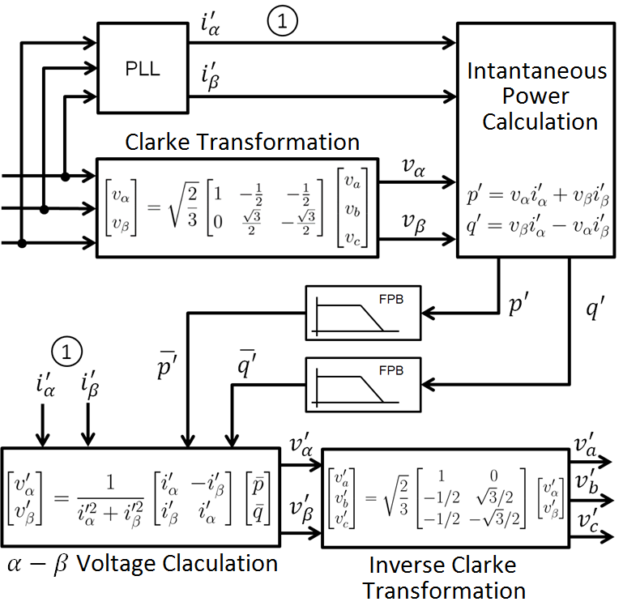















GEN
$$v_{a}$$
$$i_{La}$$
$$i_{Lb}$$
$$i_{Lc}$$
$$v_{b}$$
$$v_{c}$$
$$V_{dc_{ref}}$$
$$V_{dc}$$
3
-
+
Compensator
PWM
$$i_{Ca}^{∗}$$
Inverse Clarke Transformation
PI Controller
Hysteresis Controller
$$i_{Cb}^{∗}$$
$$i_{Cc}^{∗}$$
$$p_{loss}$$
$$i_{Cα}^{∗}$$
$$i_{Cβ}^{∗}$$
Clarke Transformation
2
Instantaneous Power Calculation
$$v_{α}^{′}$$
$$p$$
$$\overline{p}$$
$$−\tilde{p}+p_{loss}$$
FPB
+
$$v_{β}^{′}$$
+
-
$$i_{α}$$
$$i_{β}$$
$$q$$
$$−q$$
$$−1$$
$$α−β$$
Current Calculation
$$v_{α}^{′}$$
$$v_{β}^{′}$$
Positive Sequence VoltageDetector
$$i_{La}$$
$$i_{Lb}$$
$$i_{Lc}$$
Active Filter Reference Definition
2
3
Current Reference Calculator

Slide 17
